Slide 1


Recent top physics results from CMS
LHC Seminar
Tuesday, 25 February 2014
Rebeca Gonzalez Suarez

Slide 2
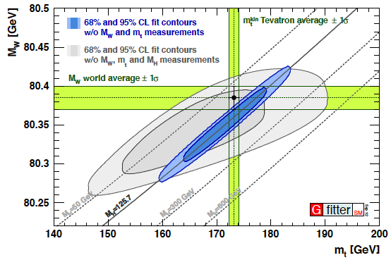

The top quark
It is the heaviest elementary particle known
large coupling to the Higgs boson
candidate to play a special role in the EW symmetry breaking and in many scenarios of physics beyond the SM (BSM)
decays before hadronizing
direct access to properties (spin, charge, polarization…)
Discovered by the Tevatron experiments (1995)
(first collisions on November 30, 1986)
Tevatron legacy still of main importance in top physics
PRL 74, 2626–2631, PRL 74, 2632–2637

Slide 3
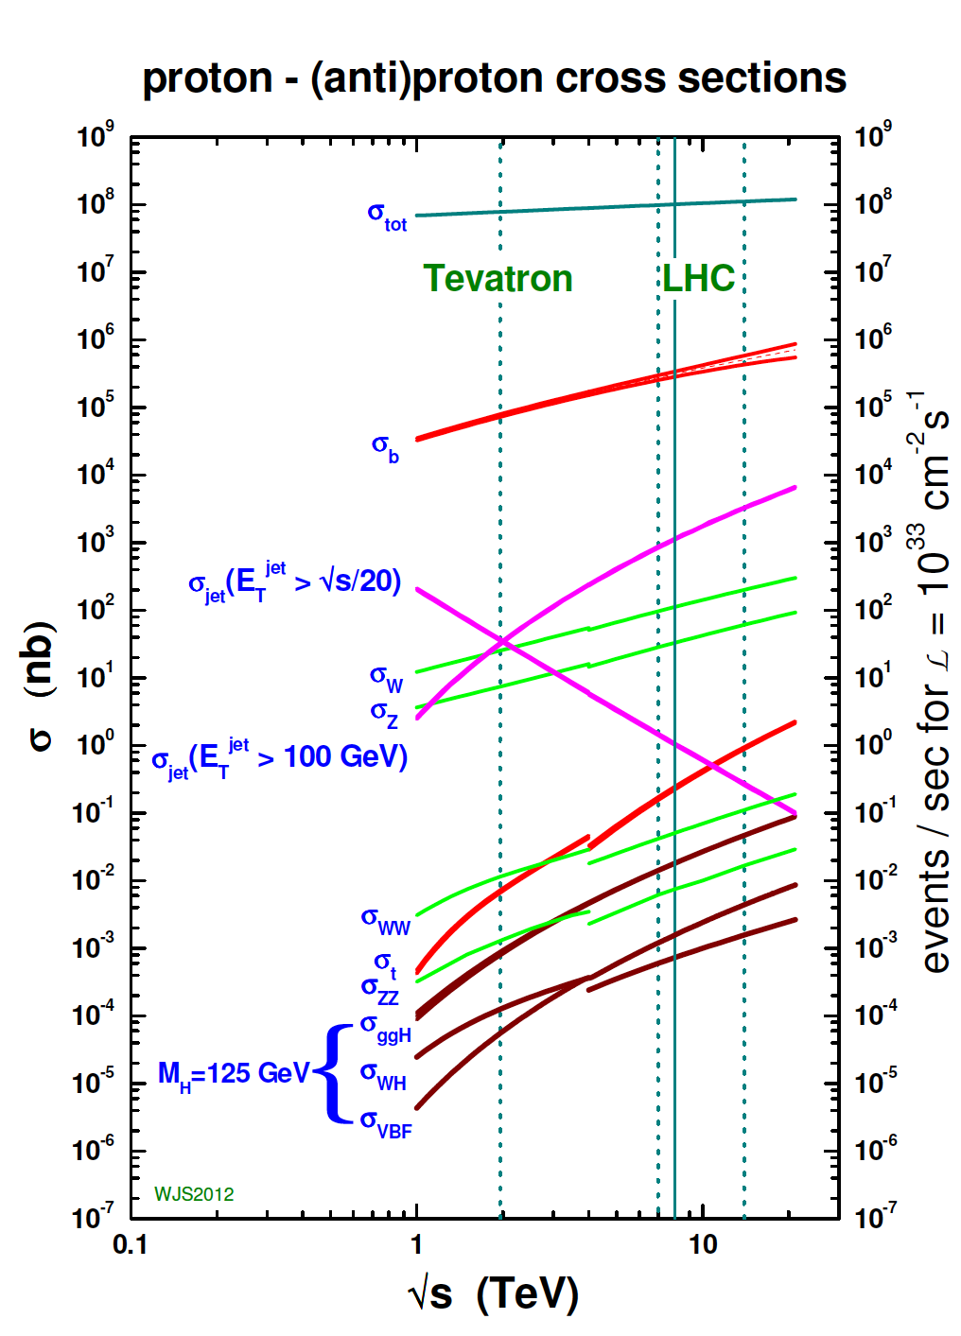
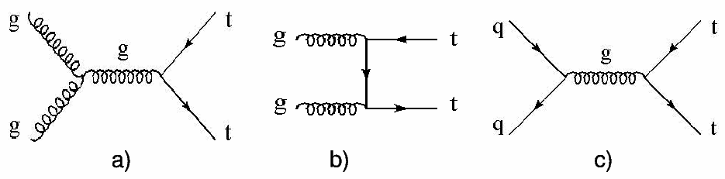

Top quarks at the LHC
At the LHC:
top quarks produced at a much higher rate
Main production: ttbar pairs, via strong interaction
x-sec (pb) | ttbar
Tevatron | 7.08 (+0.00-0.24) (+0.36-0.27) approx. NNLO
LHC @ 7TeV | 163 (+7-5)(±9) approx. NNLO
LHC @ 8TeV | 234 (+10-7)(±12) approx. NNLO
“The LHC is a top quark factory!”

Slide 4
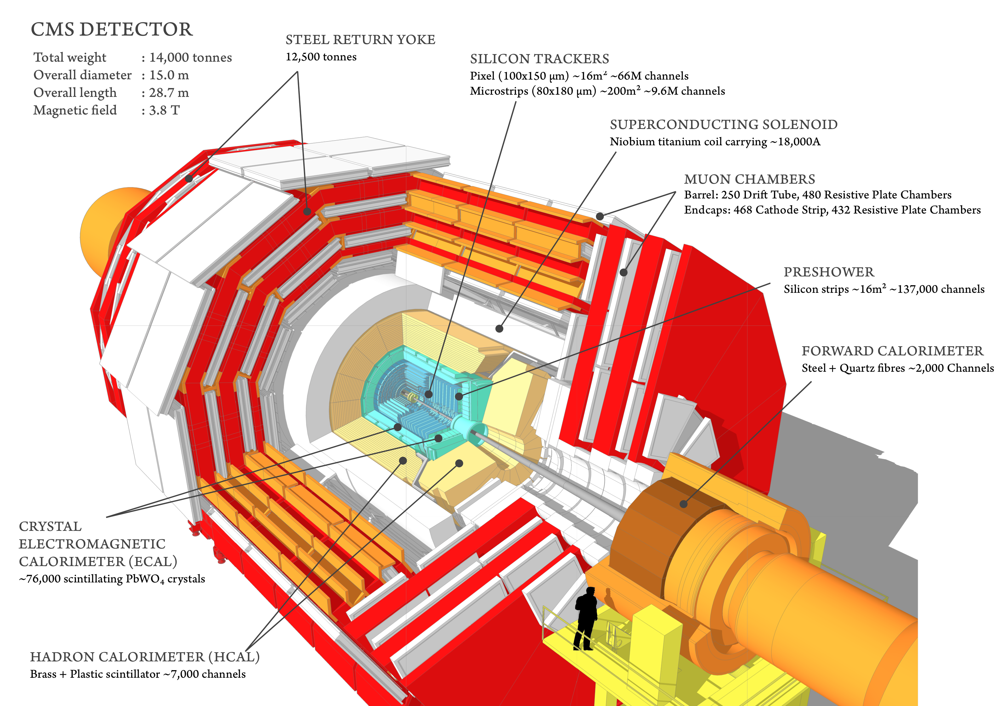
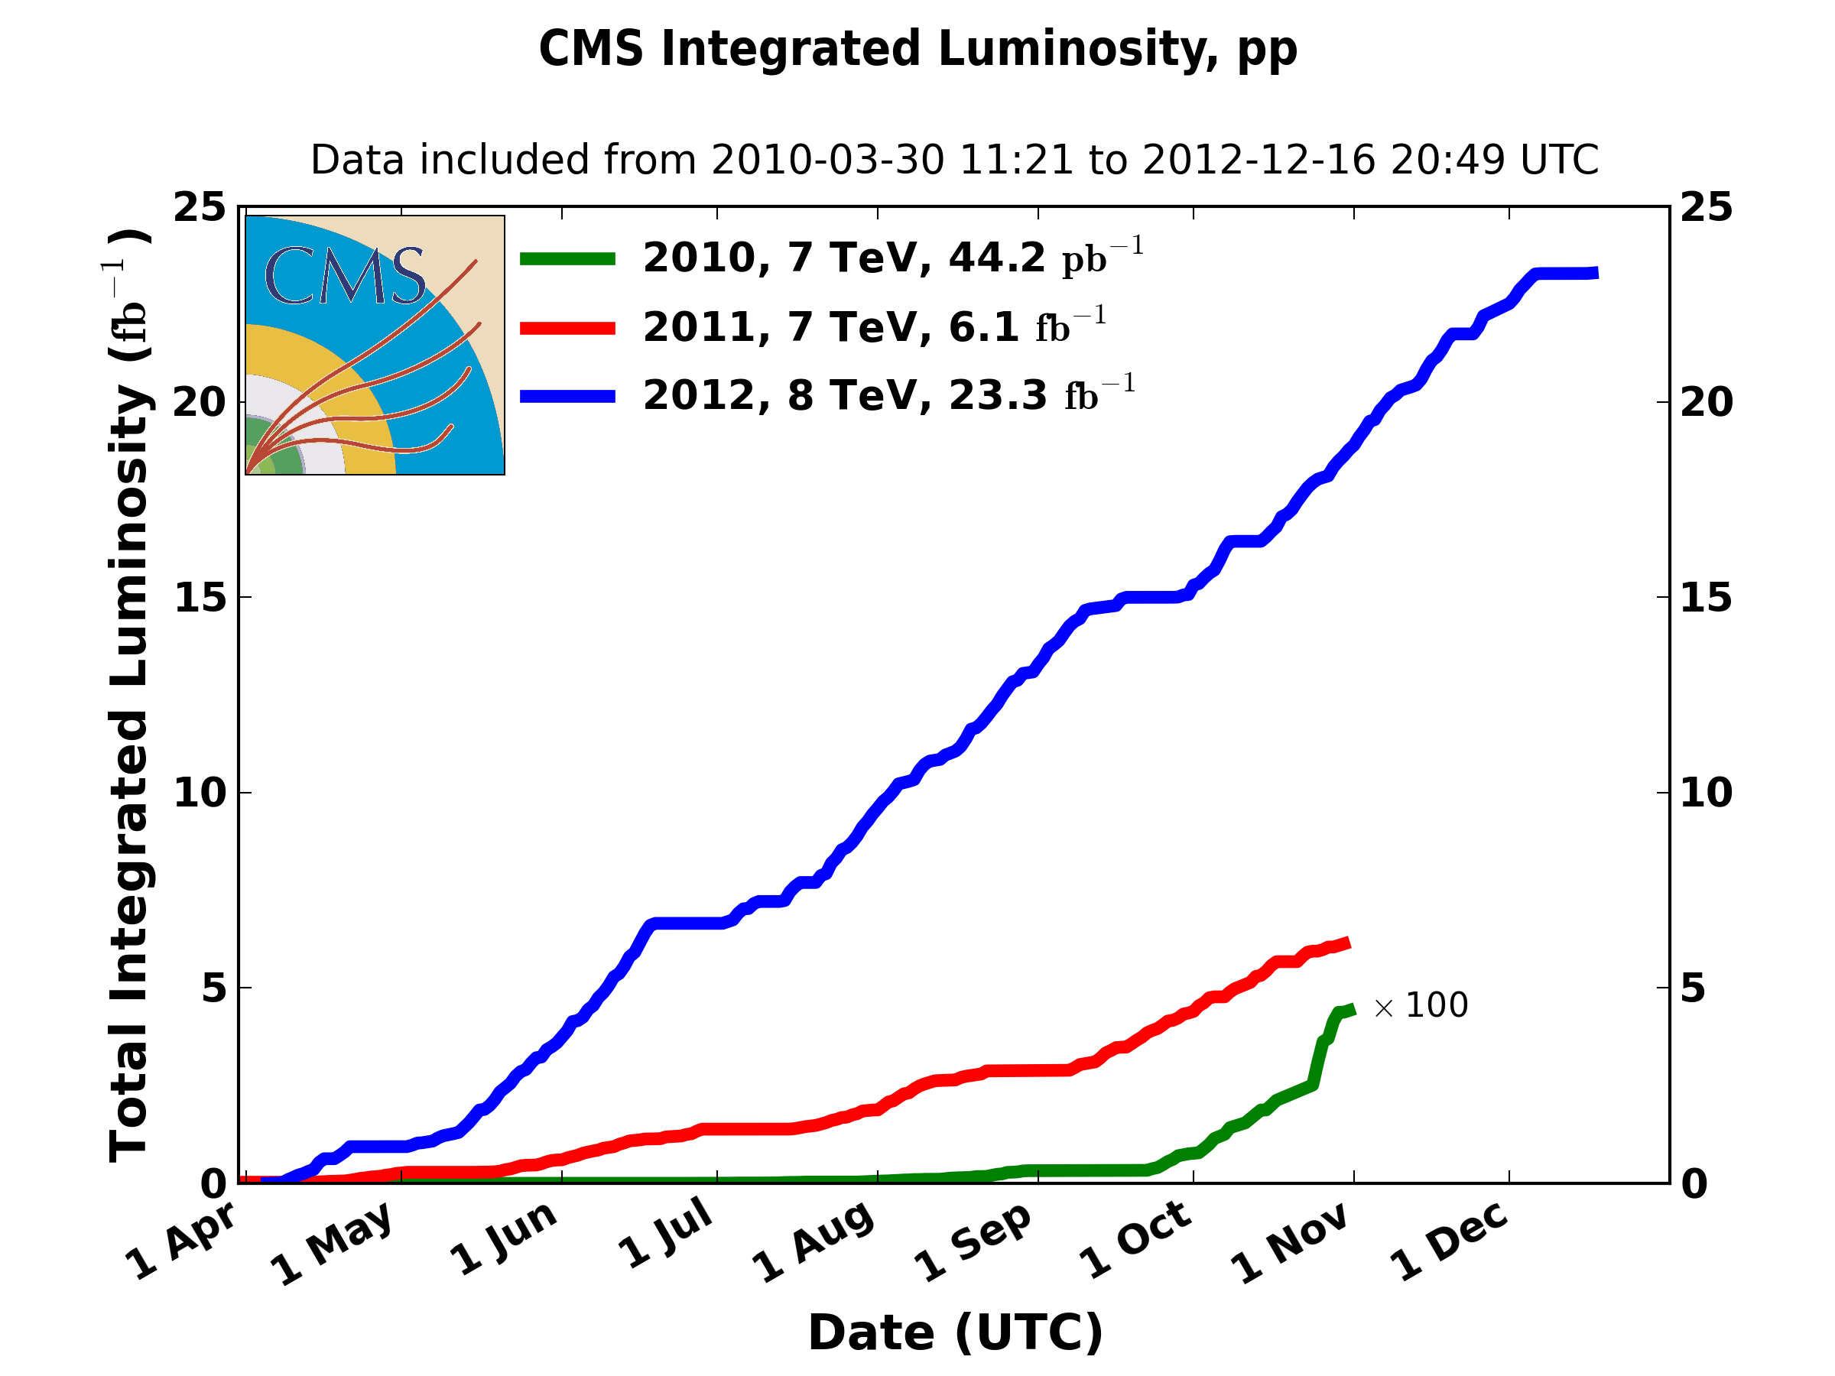
Compact Muon Solenoid (CMS)
CMS recorded
~5fb⁻¹ at 7TeV
and ~20 fb⁻¹ at 8TeV

Slide 5
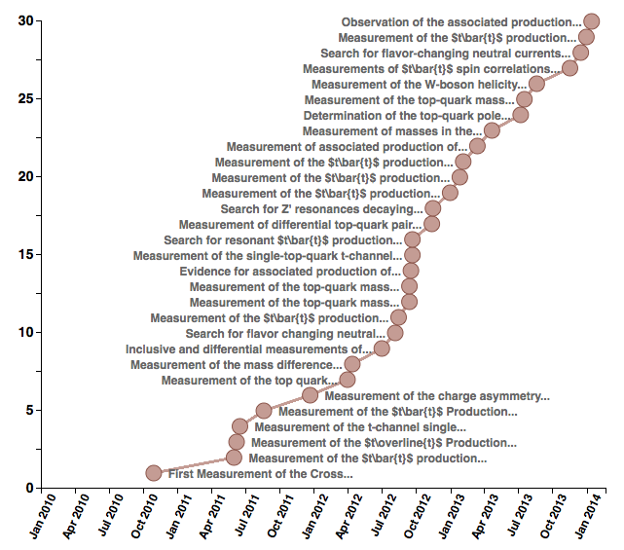
Top Physics in CMS
Since the start of the data-taking, CMS has measured and studied the ttbar and single top production modes in many final states, at 7 and 8TeV
A variety of top properties have been studied
31 papers published in standard model top physics
+ many preliminary results
This talk will cover recent results concerning:
Single top production
A selection of top properties
All the top results summarized in https://twiki.cern.ch/twiki/bin/view/CMSPublic/PhysicsResultsTOP

Slide 6
Single top results
t-channel, tW associated production, s-channel

Slide 7
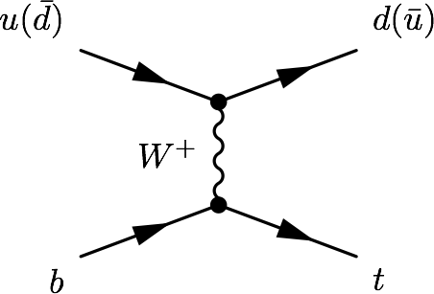
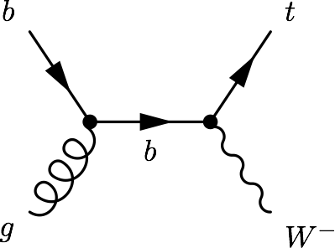
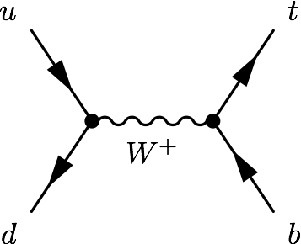
Single top production
Alternative top quark production via electroweak interaction, at a lower rate than pair production, involving a Wtb vertex
Three main processes: t-channel, tW associated production, s-channel
sensitive to many models of new physics
FCNC, Anomalous couplings
New particles (W’, charged Higgs)
characteristic scenario in which to perform SM measurements:
Top polarization, W helicity, top mass, |V_{tb}|
background to searches (Higgs, SUSY)

Slide 8
Single top world status
First observed at the Tevatron (2009)
At the Tevatron:
t-channel and s-channel were observed (s-channel fresh from last Friday! arXiv:1402.5126 ), tW associated production was not accessible
CMS presented the first t-channel studies with 7TeV data early 2011
Since then, all the main modes have been studied, the t-channel has been used to measure SM properties, the tW has been discovered, and single top related signatures have been explored on the search for new physics
PRL103:092002, PRL.103:092001
σ [pb] | t-channel | tW | s-channel
Tevatron (1.96 TeV) | 2.08 | 0.22 | 1.046
LHC (7 TeV) | 64.6 | 15.6 | 4.59
LHC (8 TeV) | 87.1 | 22.2 | 5.55
Established
Not accesible
Established
Established
Evidence
… ATLAS
Established
Established
… CMS
Established: observed with ≥ 5σ significance. Evidence : ≥ 3σ
“The LHC is a SINGLE top quark factory!”

Slide 9
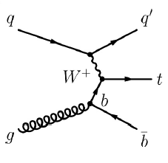
t-channel
Dominant process with the highest cross section at the Tevatron and the LHC
The final state studied is a lepton + jets signature
Signal events characterized by:
One isolated muon or electron
Missing transverse energy (MET)
A central b jet
light-quark jet from the hard scattering process (often forward)
Additionally, a second b jet produced in association to the top quark
Main backgrounds: W+jets, ttbar, multijet
Leptonic top decay
Measurement at 7TeV:
JHEP12(2012) 035

Slide 10

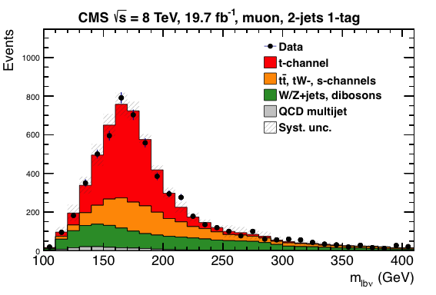
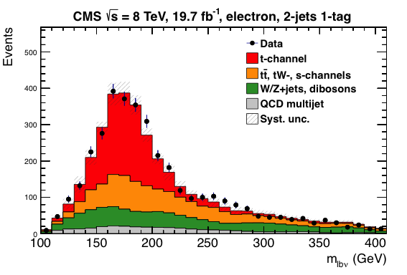
t-channel at √s = 8 TeV: Analysis
Paper TOP-12-038 (to be submitted to JHEP)
Fit on |η_{j’}|, pseudorapidity of the recoiling light jet exploiting forward kinematics
Event selection
1 isolated lepton (µ/e)
Kinematic cuts (anti QCD): m_{T} (W) (µ) / MET (e)
Several exclusive regions using jet and b-tag multiplicity (Njets-Mtag):
Signal extraction 2jets-1tag region, divided into “signal region” (SR) and “sideband” (SB) (130 < m_{lνb} < 220 GeV)
SR
SR

Slide 11
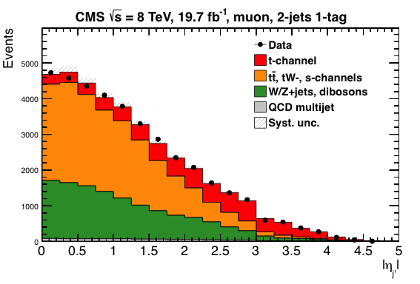
t-channel at √s = 8 TeV: Analysis
Paper TOP-12-038
Other regions used as Control Regions
ttbar: 3jets-1tag, 3jets-2tag
W/Z+jets: 2jets-0tag
Background estimation:
QCD multijet: Maximum likelihood fit to MET (e) or m_{T}(W)(µ) before cut. Template from data, inverting isolation.
W/Z+jets: From SB to SR
tt: normalization from simulation, template from 3jet-2tag region
σ_{t-channel} = 83.6±2.3(stat.)±7.4(syst)pb σ^{th}_{t-channel} = 87.2+2.8-1.0(scale)+2.0-2.2(PDF)pb (app. NNLO)*
*arXiv:1205.3453

Slide 12
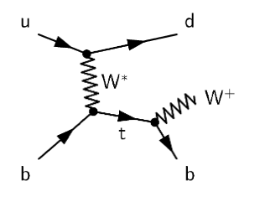
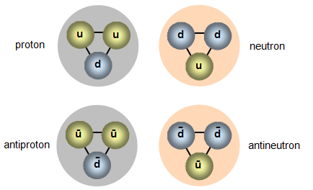
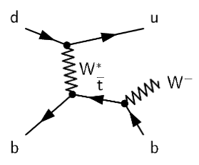
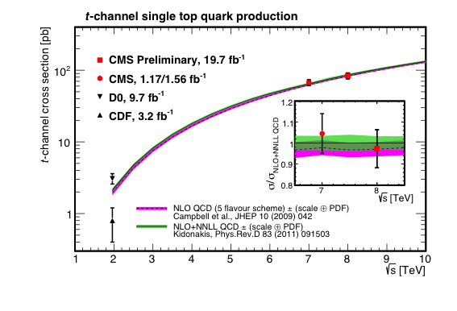
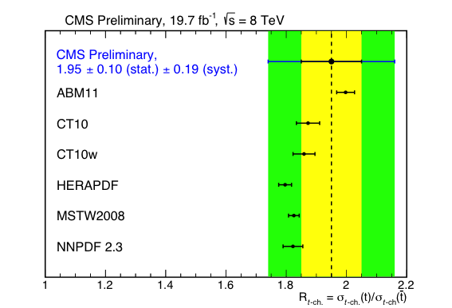
t-channel at √s = 8 TeV: Results
Paper TOP-12-038
Due to the relative proportion of u and d quarks in the proton, more tops than anti-tops are expected to be produced
σ_{top} = 53.8±1.5(stat.)±4.4(syst)pb σ^{th}_{top} = 56.4+2.1-0.3(scale)±1.1(PDF)pb
σ_{anti-top} = 27.6±1.3(stat.)±4.4(syst)pb σ^{th}_{anti-top} = 30.7±0.7(scale)+0.9-1.1(PDF)pb

Slide 13
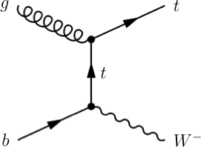
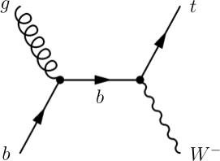
tW associated production
Single top process with the second largest cross-section at the LHC, inaccessibly small at the Tevatron
ATLAS showed evidence at 7 TeV quickly followed by CMS (first experiments study this process)
The final state studied is a dilepton signature
Signal events are characterized by:
Two opposite-sign, isolated leptons
Missing transverse energy (2 neutrinos in the final state)
A jet coming from a b decay
Backgrounds: ttbar (main challenge), DY
Evidence at 7TeV:
Phys.Rev.Lett 110, 022003 (2013)

Slide 14
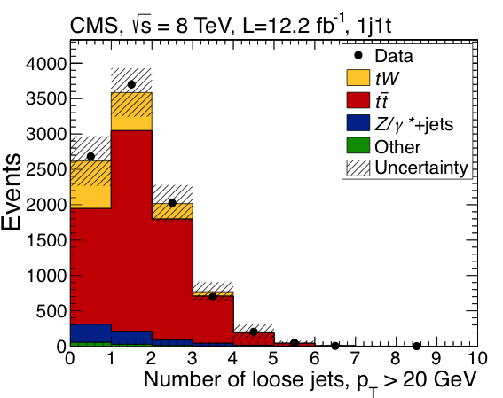
tW at √s = 8 TeV: Analysis
arXiv:1401.2942
Submitted to PRL
12.2fb⁻¹
Event selection:
2 isolated leptons, opposite charge (e,µ)
Vetoing Z mass window (m_{ll}), MET cut
Regions:
Signal: Exactly 1 jet, b-tagged (1j1t)
Control Regions: Exactly 2 jets either one or both of them b-tagged (2j1t and 2j2t)(ttbar)
Background estimation:
ttbar: 2 control regions included in the fit.
Z+jets: MET-dependent data-driven scale factors. Inverting Z mass cut
ttbar with 1 jet outside acceptance or miss-reconstructed → main background
Handle to discriminate tW and ttbar: jets that have not been selected by the main quality criteria (looser pt cut, more open η angle, b-tagging information)

Slide 15
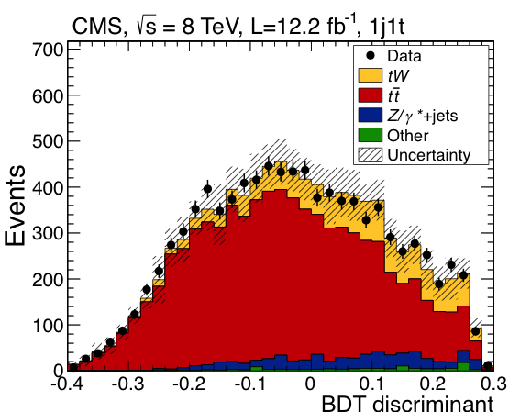
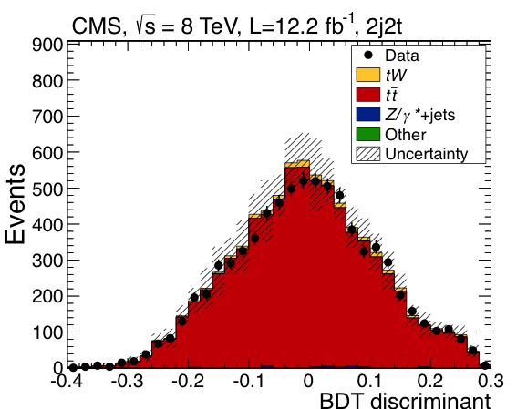
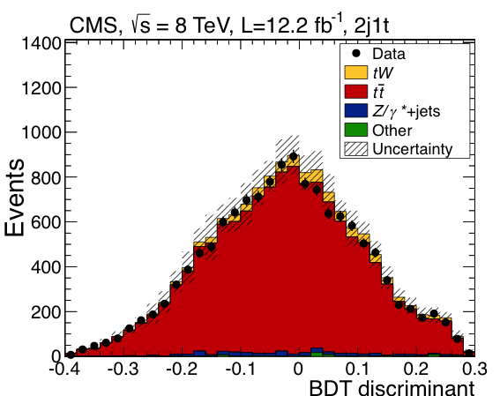
tW at √s = 8 TeV: Analysis
arXiv:1401.2942
Submitted to PRL
BDT build with 13 variables (variables related to loose jets most powerful to discriminate)
2 control regions of ttbar included in the fit

Slide 16
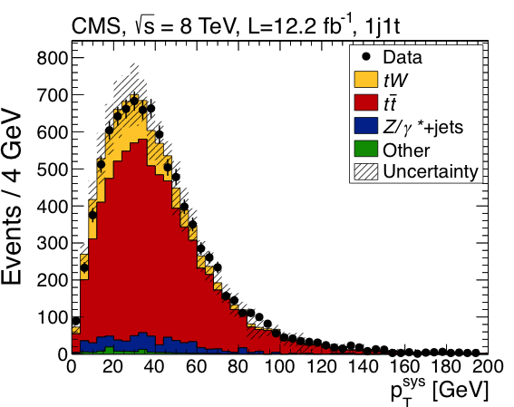
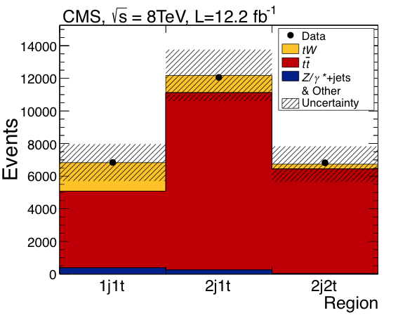
tW at √s = 8 TeV: Results
arXiv:1401.2942
Submitted to PRL
tW signal observed with a significance of 6.1σ (expected significance 5.4±1.4σ)
σ_{tW} = 23.4±5.4pb σ^{th}_{tW} = 22.2±0.6(scale)±1.4(PDF)pb (app. NNLO)*
|V_{tb}| = 1.03±0.12(exp.)±0.04(th.) →|V_{tb}| > 0.78 (95% CL)
First observation of the process!
Two cross-check analyses
Same selection + additional cut in eµ
Fit on shape of p_{T} of the system (leptons, jet, MET), and event counting
Fit to the p_{T} of the system | 4.0σ (3.2+0.4-0.9) σ_{tW} = 24.3+8.6-8.8 pb
Cut-based analysis | 3.6σ (2.8+0.9-0.8σ) σ_{tW} = 33.9+8.6-8.6 pb
*arXiv:1210.7813

Slide 17
s-channel
Lowest cross-section at the LHC, more important at the Tevatron (where the study of data after the shutdown allowed for the observation of the process)
Production mode sensitive to new physics: W’ bosons, charged Higgs bosons
Very challenging final state: low cross-section, difficult to separate from backgrounds
Signal signature: lepton + jets
A lepton (e,µ) and MET from the decay of a W boson
Two jets with high transverse momentum originating from b-quarks
Main backgrounds: W+jets and ttbar, multijet

Slide 18
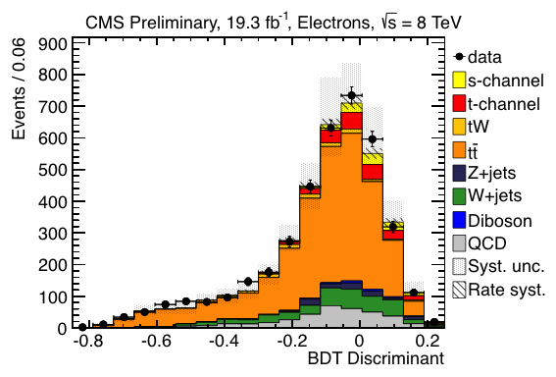
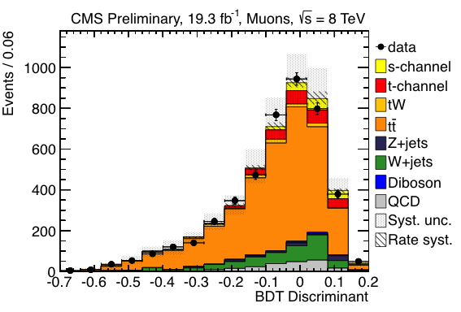
s-channel at √s = 8 TeV: Analysis
CMS-PAS-TOP-13-009
First CMS result on this channel
Event Selection
1 isolated lepton (µ/e)
2 b-tagged jets
Background estimation:
QCD : data-driven. Maximum likelihood fit to MET (e) or m_{T}(W)(µ). Template from data inverting isolation.
ttbar: control region included in the fit (3jet-2tag)
Multivariate analysis based on a BDT
11 variables (e), 10 (µ); no single “golden” discriminant variable

Slide 19
s-channel at √s = 8 TeV: Results
CMS-PAS-TOP-13-009
σ_{s-channel} = 6.2±5.4(exp.)±5.9(th)pb = 6.2+8.0-5.1 pb (FC*) σ^{th}_{s-channel} = 5.55 ± 0.08 (scale) ± 0.21(PDF) pb (NNLL)**
Observed significance of the s-channel signal 0.7σ Expected significance 0.9σ
Upper limit of 2.1 (3.1,1.6) times the SM → 11.5 (17.0,9.0) pb
* 68%CL interval using the Feldman-Cousins unified approach which does not reach negative x-sec values
**arXiv:1205.3453

Slide 20
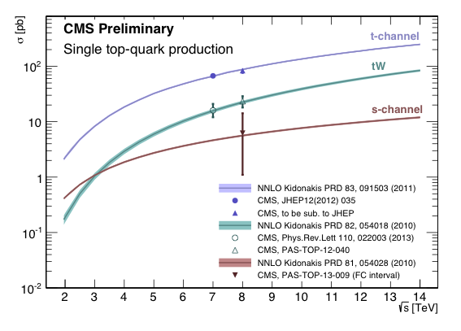
Single top in CMS

Slide 21
Top properties

Slide 22

Top properties
To fully characterize the top quark, its mass, couplings, and other properties need to be measured and established
Test consistency of SM predictions
Search for hints of new physics in deviations from SM
In CMS many top measurements have been performed
The high rate of top production at the LHC allowed competitive measurements since early data taking
ttbar events have been classically used to study top properties
The single top production at the LHC is large
enough to measure top properties
Complementary approach
Valuable to get the full picture

Slide 23
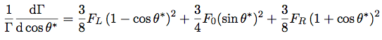
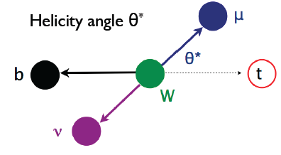
W-helicity fractions
In the SM, t→Wb (most of the time)
W (massive, spin 1 boson) can have longitudinal, left- or right-handed helicity states
Assuming SM couplings:
helicity fractions: ~70% longitudinal (F₀), ~30% left-handed (F_{L}), 0% right-handed (F_{R}) -due to helicity suppression at LO (unitarity condition: F₀+F_{L}+F_{R}=1)
Helicity fractions can be extracted from the angular distributions of the top decay products:
Helicity angle, θ* : Angle between the momentum of the d-type fermion (lepton in leptonic decays) in the W boson rest frame, and the momentum of the W boson in the top quark rest frame
Direct probe of the Wtb vertex, sensitive to BSM effects

Slide 24
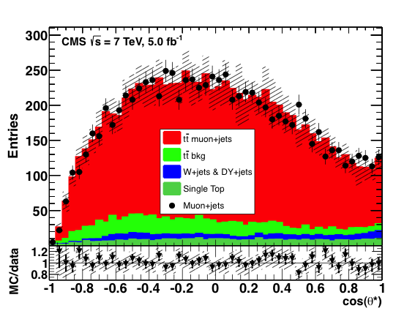
W-helicity in lepton+jets tt events (7TeV)
JHEP 10 (2013) 167
Event selection
1 isolated lepton (µ/e); ≥ 4 Jets, at least 2 b-tagged
m_{T} (W) cut against QCD
ttbar reconstructed using a kinematic fit using W and top mass constraints
W+jets and Z/γ+jets partially data-driven (normalization by exploiting charge asymmetry and from control region with 1 additional lepton)
Simulation reweighted using generator level cosθ* distribution to obtain any helicity scenario
2D (F₀ free parameter, F_{R}=0, F_{L} = 1-F₀) and 3D (F₀, F_{L} free, F_{R} constrained as 1-F₀-F_{L}) fits
cosθ*_{lep} and cosθ*_{had} considered
Most precise 3D: combined e/µ results, leptonic
F_{L} = 0.310 ± 0.022 (stat.) ± 0.022 (syst.)
F_{R} = 0.008 ± 0.012 (stat.) ± 0.014 (syst.)
F₀ = 0.682 ± 0.030 (stat.) ± 0.033 (syst.)

Slide 25
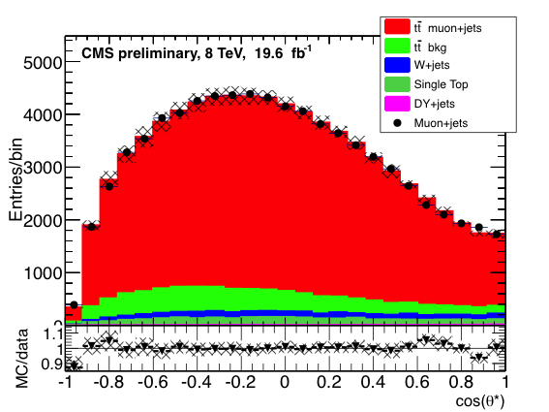
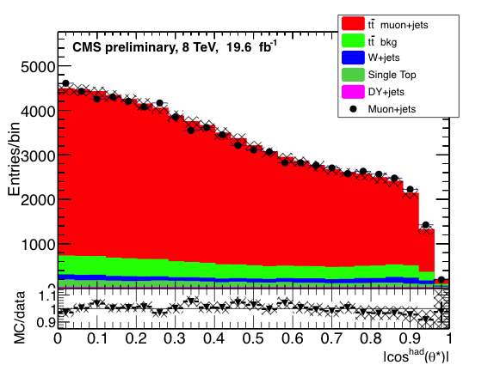
W-helicity in lepton+jets tt events (8TeV)
CMS-PAS-TOP-13-008
Update of the analysis at 8TeV
σ_{tt}(8 TeV) ~ 1.6 σ_{tt}(7 TeV)
σ_{Wjets}(8 TeV) ~ 1.2σ_{Wjets}(7 TeV)
→W-helicity measurement in a purer sample
Muon channel
3D fit
Results:
F_{L} = 0.350 ± 0.010 (stat.) ± 0.024 (syst.)
F_{R} = -0.009 ± 0.006 (stat.) ± 0.020 (syst.)
F₀ = 0.659 ± 0.015 (stat.) ± 0.023 (syst.)
Leptonic branch

Slide 26
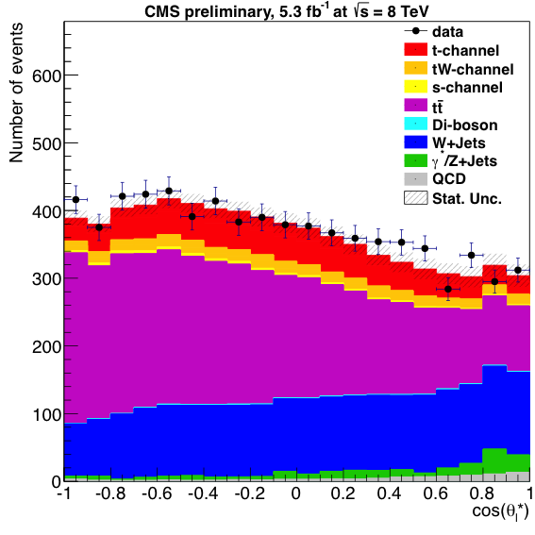
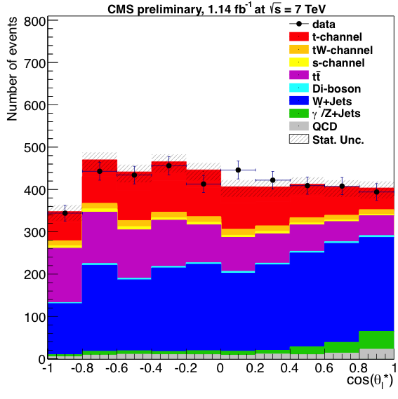
W-helicity in Single top signatures
CMS-PAS-TOP-12-020
First measurement using single top
t-channel standard (cross-section measurement) event selection
Preliminary result with only muons, 1.14fb⁻¹(7TeV) and 5.3fb⁻¹(8TeV)
F_{L} = 0.293 ± 0.069(stat.) ± 0.030(syst.)
F_{R} = -0.006 ± 0.057(stat.) ± 0.027(syst.)
F₀ = 0.713 ± 0.114(stat.) ± 0.023(syst.)

Slide 27
CMS measurements of F₀, F_{L}, F_{R}
 | 7 TeV | 8 TeV
Theory prediction (NNLO) | F_{L} = 0.311 ± 0.005 F_{R} = 0.0017 ± 0.0001 F₀ = 0.687 ± 0.005 PRD 81, 111503(R) (2010)
tt l+jets | F_{L} = 0.310 ± 0.022 (stat.) ± 0.022 (syst.) F_{R} = 0.008 ± 0.012 (stat.) ± 0.014 (syst.) F₀ = 0.682 ± 0.030 (stat.) ± 0.033 (syst.) JHEP 10 (2013) 167 | F_{L} = 0.350 ± 0.010 (stat.) ± 0.024 (syst.) F_{R} = -0.009 ± 0.006 (stat.) ± 0.020 (syst.) F₀ = 0.659 ± 0.015 (stat.) ± 0.023 (syst.) CMS-PAS-TOP-13-008
tt dilepton | F_{L} = 0.288 ± 0.035(stat) ± 0.040(sys) F_{R} = 0.014 ± 0.027(stat) ± 0.042(sys) F₀ = 0.698 ± 0.057(stat) ± 0.063(sys) CMS-PAS-TOP-12-015
Single top t-channel | F_{L} = 0.293 ± 0.069(stat.) ± 0.030(syst.) F_{R} = -0.006 ± 0.057(stat.) ± 0.027(syst.) F₀ = 0.713 ± 0.114(stat.) ± 0.023(syst.) CMS-PAS-TOP-12-020
LHC combination (l+jet and dilep) | F_{L} = 0.359 ± 0.021 (stat.) ± 0.028 (syst.) F_{R} = 0.015 ± 0.034 F₀ = 0.626 ± 0.034 (stat.) ± 0.048 (syst.) CMS-PAS-TOP-12-025

Slide 28
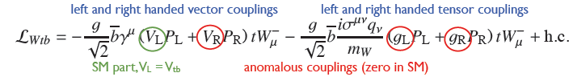
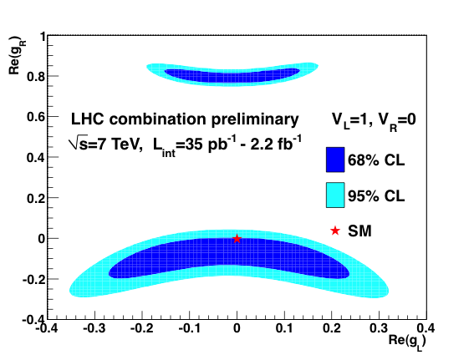
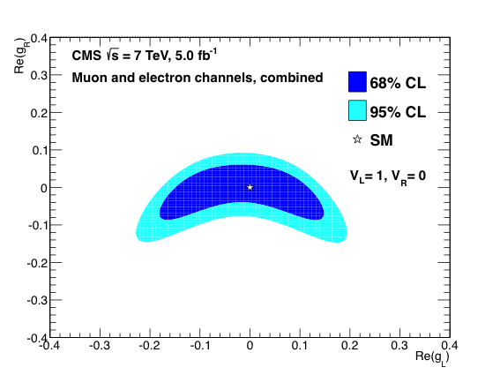
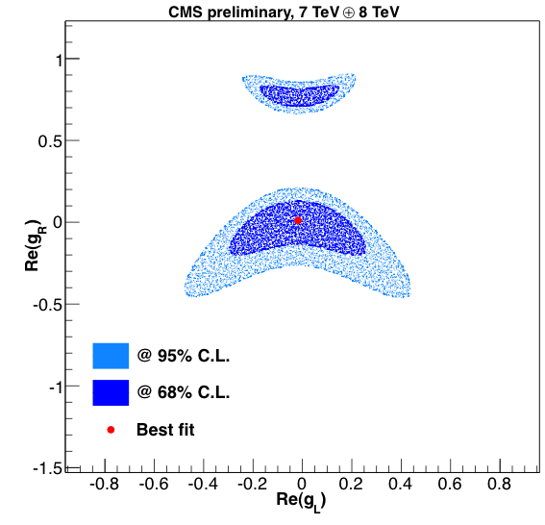
Limits on anomalous couplings
Deviations on the measured helicity fractions from the SM can be interpreted in terms of anomalous Wtb couplings
General Wtb vertex lagrangian:
limits set on real components of g_{L} and g_{R}
disfavored by single top
cross-section measurements
JHEP 10 (2013) 167
CMS-PAS-TOP-12-020
CMS-PAS-TOP-12-025

Slide 29
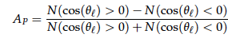
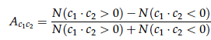
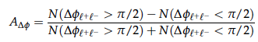
Top polarization and spin correlations
spin of the top in generation → decay products
Information retrieved from angular distributions
Measurements using angular asymmetry variables (unfolded to parton level)
Top spin studied in ttbar using θ_{l} (angle of lepton in parent top’s rest frame, relative to the direction of the top in the ttbar center of mass frame)
ttbar → tops unpolarized: polarization P given by P = 2A_{P}, where A_{P} is
A_{c1c2}
And finally A_{Δϕ} , sensitive to ttbar spin correlations
Direct measure of spin correlation coefficient C_{hel} using helicity angles of the two leptons in each event: C_{hel} = -4A_{c1c2}
c₁ = cos(θ_{l+}), c₂ = cos(θ_{l-})
discrimination between correlated and uncorrelated top and anti-top spins

Slide 30
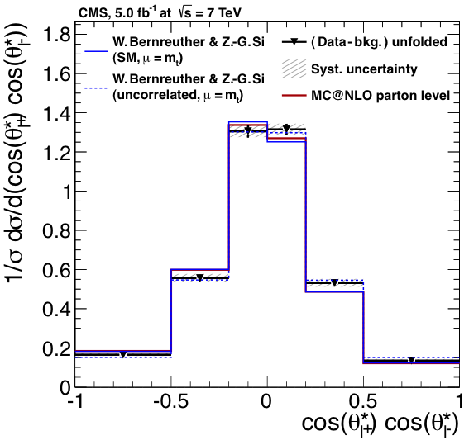
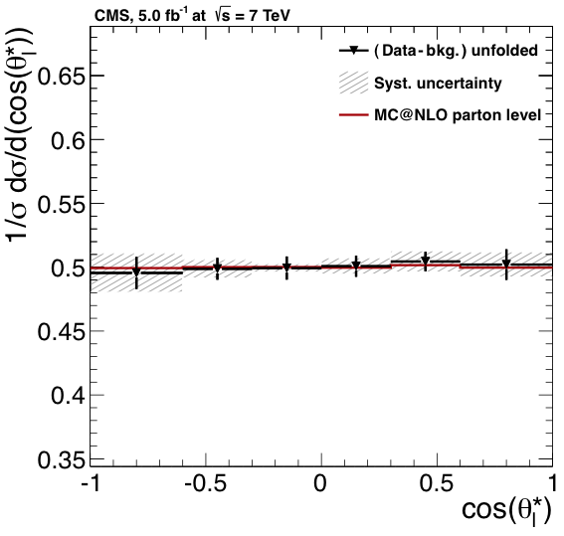
Polarization and spin in tt dilepton
arxiv:1311.3924
Submitted to PRL
7TeV
Event selection
2 isolated leptons (e, µ); ≥ 2 jets, ≥1 b-tagged
ee/µµ: vetoing Z mass window (m_{ll}), MET cut
Analytical matrix weighting technique (AMWT) to reconstruct ttbar system
Regularized unfolding algorithm
distributions corrected for detector effects allowing for direct comparison with theoretical predictions

Slide 31
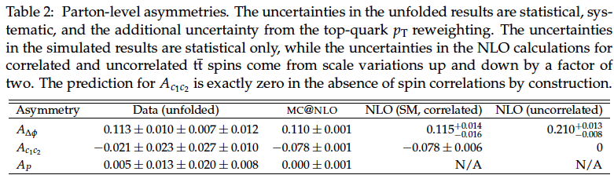
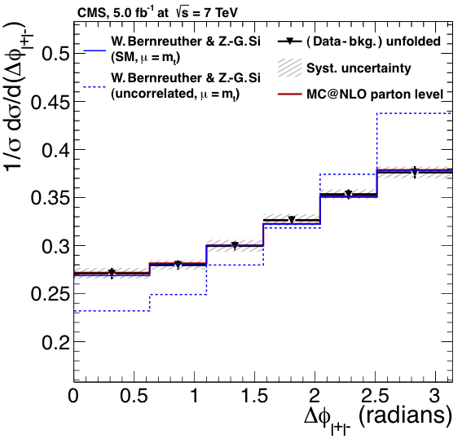
Polarization and spin in tt dilepton
arxiv:1311.3924
Submitted to PRL
The Asymmetries determined from the unfolded distributions are also at parton level
Uncertainties are statistical, systematic, and from the modeling of the top p_{T} distribution
A_{ΔΦ} result indicates tt spin correlations, disfavoring the uncorrelated case

Slide 32
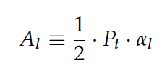
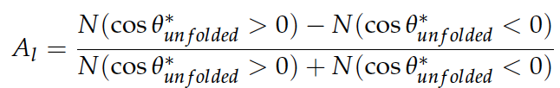
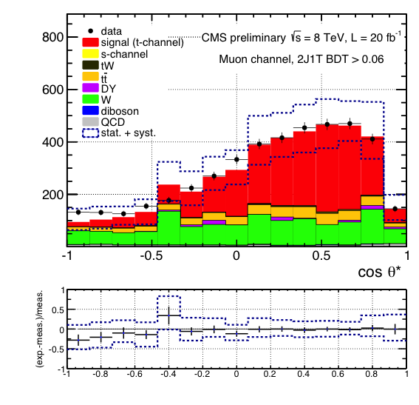

Top polarization in single top
CMS-PAS-TOP-13-001
Single top quarks → highly polarized, spin aligned with the recoiling light jet
Polarization (related to the spin asymmetry) measured from unfolded cosθ*_{l} distribution (angle between the charged lepton and the untagged jet in the top quark rest frame) using the spin asymmetry
Analysis performed at 8TeV (e/µ)
t-channel event selection, BDT discriminant built to obtain a signal enriched sample
Cut on optimal
S/B point

Slide 33


Top polarization in single top: Results
CMS-PAS-TOP-13-001
cosθ_{l} distributions unfolded to parton level, used to extract the top-quark spin asymmetry
e/µ results combined with BLUE
top-quark spin asymmetry A_{l}=0.41±0.06(stat.)±0.16(syst.) (SM expectation 0.44)
top-quark polarization P_{t}=0.82±0.12(stat.)±0.32(syst.) (assuming the spin analyzing power of a charged lepton –α_{l}- is 100% -SM)

Slide 34


Charge asymmetry
Tevatron found a potential hint for new physics in the top quark sector → discrepancy of measured ttbar forward–backward asymmetry with SM expectations (>2σ effect)
Correlation between the direction of the momentum of the top (anti-top) quark and incoming quark (anti-quark)
Forward–backward asymmetry (A_{FB}) at the Tevatron (proton-antiproton collider)
Not the case at the LHC (proton-proton)
At the LHC, larger average momentum fraction of valence quarks → excess of top quarks in the forward and backward directions, anti-top quarks produced more centrally.
Variable used (y = rapidity)

Slide 35



Charge asymmetry: dilepton tt events
arXiv:1402.3803
Submitted to JHEP
7TeV
Event selection
2 isolated leptons, removing Z mass window (ee/µµ)
≥ 2 Jets; ≥ 1 btag
MET cut
Fake lepton background from data, Z+jets from in/out Z mass window
ttbar system reconstructed (AMWT)
Charge asymmetry and lepton charge asymmetry

Slide 36


Charge asymmetry: lepton+jets tt events
CMS-PAS-TOP-12-033
8 TeV
Event selection
1 isolated lepton (µ/e) ≥ 4 Jets, at least 1 b-tagged
Background estimation
Fit on regions of m_{T}(W) (leptonic decay), fitting M₃ (mass of the 3 jets on the hadronic side) simultaneously; QCD from data inverting the isolation
Reconstructed tt system
inclusive and differential distributions of Δ|y|
EAG: model featuring an effective axial-vector coupling of the gluon PRD 8 (2011) 054017

Slide 37
CMS measurements of charge asymmetry
 | 7 TeV | 8 TeV
Theory prediction (NLO) | 0.0123 ± 0.0005 PRD 86, 034026 (2012) | 0.0111 ± 0.0004 PRD 86, 034026 (2012)
tt l+jets | 0.004 ± 0.010 (stat.) ± 0.011 (syst.) PLB 717 (2012) 129 | 0.005 ± 0.007 (stat.) ± 0.006 (syst.) CMS-PAS-TOP-12-033
tt dilepton | -0.010 ± 0.017 (stat.) ± 0.008 (syst.) arXiv:1402.3803
Everything in agreement with SM predictions

Slide 38



FCNC in ttbar events, t→Zq
arXiv:1312.4194
Submitted to PRL
Flavor Changing Neutral Currents in top decays using ttbar events, 8TeV
t→Wb ~100% of the times, t→Zq highly suppressed by the GIM mechanism, predicted B(t →Zq) O(10⁻¹⁴)
Event selection:
3 leptons, (µ, e) (pair compatible with Z decay)
≥2 jets; 1jet b-tagged
MET cut
Background estimation
using b-tag information
0,>1 tag samples
Cuts on m_{Wb} and m_{Zq}

Slide 39


FCNC in ttbar events, t→Zq
arXiv:1312.4194
Submitted to PRL
Upper 95% CL limits for B(t→Zq )
~ four times lower than the previous
in this channel
Projections of the sensitivity of the analysis at high energy and luminosity
t →Zq decays at a high rate would indicate BSM physics
Extensions of SM predict enhancement of B(t →Zq) as large as O(10⁻⁴)
CMS-PAS-FTR-13-016

Slide 40

FCNC in single top events, tZ
CMS-PAS-TOP-12-021
7 TeV
Single top quark produced in association with a Z (tZ),
Signature sensitive to both Zqt and gqt anomalous vertices
Event selection:
3 leptons, (e, µ) (one pair compatible with a Z decay), exactly1 b-jet
Cut on m_{T}(W)
Main background from fake leptons (Z+jets):
shapes from data, inverting third lepton isolation + low MET
Analysis based on a BDT discriminant
11 variables, all the leptonic final states together

Slide 41



FCNC in single top events, tZ
CMS-PAS-TOP-12-021
Limits on couplings and branching fractions:
Ztq promising

Slide 42



TOP LHC Working Group
There’s an open dialogue between the LHC experiments and the theory community in the context of the TOP LHC working group
ATLAS and CMS coordinate efforts in top physics to provide combination of experimental results
5 preliminary results (top cross-section, mass, single top, W-helicity)
CMS-PAS-TOP-12-002, ATLAS-CONF-2013-098
CMS-PAS-TOP-12-025, ATLAS-CONF-2013-033

Slide 43
Summary I
Single top quark production was observed for the first time in 2009 by the Tevatron
It has been studied in CMS in the three main production modes
t-channel: observed in early data, well established at 7 and 8TeV
tW associated production: never accessible before, CMS has the first observation of the process at 8TeV, evidence was found at 7TeV
s-channel: extremely challenging signature, work is in progress, with a first result in this channel at 8TeV
Search for new physics (Anomalous couplings, FCNC) also performed in single top events
The t-channel sample is so large that it can already be exploited to perform measurements of top properties
|V_{tb}|, W-helicity fractions, top polarization (more to come)
Moving towards a full characterization of the top quark using all its production modes

Slide 44

Summary II
For the full characterization of the top quark, the measurement of top properties is necessary
Is the top a SM one?
Will we find surprises?
Wide catalog of top properties measured in CMS
Reported today:
W-helicity fractions
Related to the angular distribution of the top decays, used to set limits on Anomalous Couplings
Top polarization and spin correlations
From the angular correlations of the decay products in tt events
Charge asymmetry
Using the kinematics of the top and anti-top quarks (Tevatron has a 2σ effect with respect to the SM)
Flavor Changing Neutral Currents in top decays and production
OR
?

Slide 45
Backup slides

Slide 46


t-channel at √s = 8 TeV: Systematics

Slide 47

tW at √s = 8 TeV: BDT Variables
arXiv:1401.2942
Submitted to PRL

Slide 48

tW at √s = 8 TeV: Systematics
arXiv:1401.2942
Submitted to PRL

Slide 49


s-channel at √s = 8 TeV: Variables
CMS-PAS-TOP-13-009
2jet-2tag electron channel
2jet-2tag muon channel

Slide 50

W-helicity in lepton+jets tt events (7TeV)
JHEP 10 (2013) 167

Slide 51



W-helicity in lepton+jets tt events (7TeV)
JHEP 10 (2013) 167

Slide 52

W-helicity in lepton+jets tt events (8TeV)
CMS-PAS-TOP-13-008

Slide 53




W-helicity in Single top signatures
CMS-PAS-TOP-12-020
7TeV
8TeV

Slide 54

Polarization and spin in tt dilepton
arxiv:1311.3924
Submitted to PRL

Slide 55


Top polarization in single top
CMS-PAS-TOP-13-001

Slide 56

Charge asymmetry

Slide 57

Charge asymmetry: dilepton tt events
arXiv:1402.3803
Submitted to JHEP

Slide 58

Charge asymmetry: lepton+jets tt events
CMS-PAS-TOP-12-033

Slide 59

FCNC in ttbar events, t→Zq
arXiv:1312.4194
Submitted to PRL

Slide 60
Event selections
t-channel 8TeV (paper TOP-12-038)
1 isolated lepton, µ(e) p_{T} > 26 (30) GeV; |η| < 2.1 (2.4)
Jets: Anti-kt (0.5) p_{T} > 40 GeV, |η|< 4.5; b-tagging
m_{T} (W) > 50 GeV (µ) / MET > 45 (e)
tW observation (arXiv:1401.2942)
2 leptons, opposite charge µ(e) p_{T}> 20 GeV, |η| < 2.4(2.5), isolated
1or 2 jets: p_{T} > 30 GeV, |η| <2.4 corrected
(+ loose jets: failing p_{T}/|η| ; p_{T} > 20 GeV, |η|< 4.9), b-tag
m_{ll} > 20 GeV
ee/µµ: veto events with 81 < m_{ll} < 101 GeV
MET > 50 GeV
s-channel (CMS-PAS-TOP-13-009)
1 isolated µ(e) p_{T} (E_{T}) > 26 (30) GeV, |η| < 2.1 (2.4)
2 b-tagged jets p_{T} > 40 GeV, |η| < 4.5

Slide 61
Event selections (II)
W-helicity (7TeV) JHEP 10 (2013) 167
1 isolated lepton µ (e) with p_{T} > 25 (30) GeV; |η| < 2.1 (2.5)
≥ 4 Jets p_{T} > 30 GeV, |η| < 2.5; at least 2 b-tagged
m_{T} (W) > 30
Spin asymetries (tt dilep) arxiv:1311.3924
2 leptons, e (µ) with p_{T} > 20 GeV |η|< 2.5 (2.4), isolated
(vetoing Z mass window for ee/µµ)
≥ 2 jets p_{T} > 30 GeV |η|< 2.5; ≥1 b-tagged
MET > 40GeV ee/µµ
Charge asymmetry arXiv:1402.3803
2 isolated leptons p_{T}> 20, |η| < 2.4, removing Z mass window (ee/µµ)
≥ 2 Jets p_{T} > 30, |η| < 2.4; ≥ 1 btag
MET > 40

Slide 62
Event selections (III)
Charge Asymetry CMS-PAS-TOP-12-033
1 isolated lepton: µ (e) p_{T} > 26 (30) GeV; |η| < 2.1 (2.5)
≥ 4 Jets p_{T} > 30 GeV, |η| < 2.5; at least 1 b-tagged
FCNC tt
3 leptons, e (µ) p_{T} > 20 GeV, |η|< 2.5 (2.4) (pair compatible with Z decay)
≥2 jets p_{T} > 30 GeV, |η|< 2.4; 1 b-tagged
MET > 30GeV
FCNC tZ
3 leptons, e (µ) p_{T} > 20 GeV |η|< 2.5 (2.4) (one pair compatible with a Z decay)
Jets p_{T} > 30 GeV and |η|< 2.4; exactly1 b-jet
m_{T}(W) > 20GeV

